Slide 1
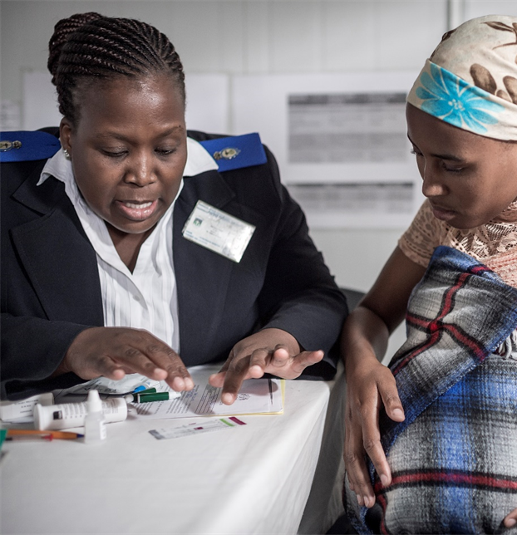


Modelling the population-level benefits and risks of using dolutegravir in first-line therapy for women and adolescent girls of child bearing potential (WCP)
Mary-Ann Davies, Caitlin Dugdale, Andrea Ciaranello, Andrew Phillips, Landon Myer
& Martina Penazzato on behalf of the Dolutegravir Modelling Working Group
Notes:
I’m going to speak briefly about some of the mathematical modelling work that contributed insights towards the guidelines revision process. I’m presenting this work on behalf of a larger group formed for this process – and the central individuals here are Caitlin Dugdale and Andrew Phillips, who led the different modelling work I’ll summarise, as well as Mary-Ann Davies who led the synthesis I’m going to show you.

Slide 2

Dolutegravir Modelling Working Group
Benefits & risks of dolutegravir
Computer simulation models of HIV infection & disease
  Useful tools in policy situations where we do not have empirical observations/data
Key question: What are the potential differences in clinical outcomes at a population level associated different policy decisions around DTG use?
    NTDs, Deaths (infant, maternal), MTCT, sexual HIV transmission
    Taking into account different country scenarios and assumptions about effects of DTG vs EFV
      Draw on real-word data whenever possible: Tsepamo (updated May 2019), ADVANCE, NAMSAL
      HIV prevalence, incidence, pre-treatment drug resistance (PDR), fertility, access to contraception
Two different modelling groups have examined outcomes with various ART strategies
  Different modelling approaches, assumptions and structures
  Developed, analysed and reported independently
Notes:
When the guidelines group met in 2018, the issues related to the risks vs benefits of dolutegravir were very new, and there were no systematic, population-level quantitative considerations of the risks versus benefits that may be associated with widespread use of DTG.
The potential risks revolved around the possible association of DTG with NTDs; the possible benefits include improved rates of viral suppression leading to reduced morbidity and mortality, reduced MTCT, reduced sexual transmission
But how these risks and benefits could be brought together and compared to each other in a quantitative way wasn’t available at that time.
In the year subsequently, major epidemiologic modelling groups had time to consider these issues in great detail –
Their analyses are in the form of computer simulations – these are “thought experiments” about the implications of different policy decisions related to DTG use.
The key question that these simulations sought to answer is, “What are the potential differences in clinical outcomes, at a population level, associated with different policy decisions related to DTG use”
The clinical outcomes under consideration include NTDs, maternal and infant deaths, MTCT and sexual HIV transmission
These kinds of analyses are informed wherever possible by real data - but also require different assumptions to be made in the absence of definitive data
Importantly, what we’re going to talk about is the results of two different modelling groups that have examined these issues under different methodological approaches and model structures, working independently

Slide 3
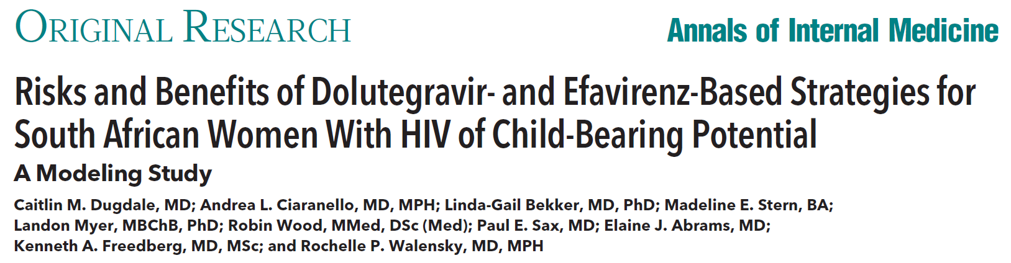
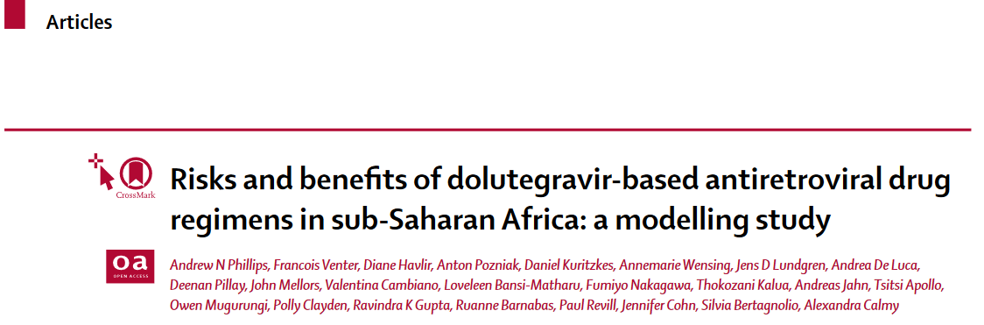

CEPAC
HIV SYNTHESIS
Notes:
Both of these models have been published – the details of the models, their assumptions and their findings are all in the public domain, the references are here
Key findings are summarised here – importantly, what I’ll summarise here is the results of analyses that include the latest available data, including updated Tsepamo results from May 2019 as well as ADVANCE and NAMSAL data. I promise I won’t break any embargoes, but the inputs and outputs here are different from the publications because the latest available data are incorporated
The top model is from a Group called CEPAC with analyses led by Caitlin Dugdale and Andrea Ciaranello, so we’ll call that CEPAC in this presentation throughout and use the blue colour when talking about those analyses; the other model is from an international consortium led by Andrew Phillips, called the HIV Synthesis model and use the green colour

Slide 4
CEPAC
HIV SYNTHESIS
HIV SYNTHESIS
WCP newly initiating ART in South Africa
219,300 WCP per year (5 years) (~1.1 million)
NNRTI PTDR of 10.7%;
SA-age specific fertility
and their 250,000 HIV-exposed infants
ART strategies
EFV / DTG / DTG-C (DTG if LA contraception)
Assumed efficacy and adverse events with DTG vs EFV based on NMA
VL monitoring: SA guidelines
NTD risk per Tsepamo May 2019; 100% mortality
MTCT calculated for in utero / intrapartum / postpartum ± ART ± viral suppression (until end BF)
Outcomes: WCP – VL<50, death, sexual transmission; Children – NTDs, MTCT, death, HIV-free survival
WCP wanting more children & newly initiating ART in SSA in population 10 million adults (20 years)
500 setting scenarios (epidemic & program settings generated from epidemic start & projected forward; scenarios are also varied)
Median values over setting scenarios
HIV prevalence 13% HIV incidence 0.86/100py
3 90s 85 / 90 / 86 NNRTI PDR 9%
Fertility 12% of women age 15-65 give birth/yr
ART strategies
TLE/ZL-PI: TDF + 3TC + EFV or TLD: TDF + 3TC + DTG
Potency of DTG = EFV; 13x lower rate of resistance
DTG weight gain: in WCP: ↑ death/morbidity;
in pregnancy: ↑ stillbirths & neonatal deaths
VL monitoring: WHO guidelines; varying coverage
NTD risk per Tsepamo May 2019; 100% mortality
(1 DALY added to mother until end of analysis)
MTCT depends on maternal VL (9% until end BF)
Outcomes: WCP – VL<50, death, sexual transmission; Children – NTDs, MTCT; Both: DALYs & costs
Notes:
The details of the two modelling approaches are summarised here – there are many details of course – but the key things to focus on are that CEPAC models the population of HIV-infected women in South Africa; HIV Synthesis models a range of scenarios consistent with different countries across sub-Saharan Africa
The models make different assumptions about how EFV or DTG are associated with different clinical outcomes; but both models examine issues of NTDs, MTCT, and survival in HIV-infected women (albeit in different ways)
The CEPAC model has two main comparisons – modelling EFV use (TLE) versus either DTG use in all (TLD), or DTG use in men and women of repro potential who have access to LARC (called DTG-C here). CEPAC includes explicit modelling of child health outcomes such as MTCT and HIV-free child survival, also.
The HIV Synthesis model compared TLE vs TLD, with a slightly different set of assumptions, and important incorporates some assumptions about DTG-associated weight gain
So the two models are tackling the same big-picture questions, with different approaches and assumptions

Slide 5
CEPAC
Imagine a group of 1000 WCP using EFV
How would outcomes compare to
  1000 women using DTG?
  1000 women, using DTG if access to contraception, otherwise EFV?

Slide 6





CEPAC: May 2019 Tsepamo
ARV efficacy per NMA, PDR 10.7%
For every 1000 South African WCP with HIV starting ART, per year, compared with EFV (average over 5 yrs):
CEPAC
DTG
DTG-C
Imagine a group of 1000 WCP using EFV
How would outcomes compare to
  1000 women using DTG?
  1000 women, using DTG if access to contraception, otherwise EFV?
DTG
1 more NTDs
0 more NTDs#
<1 fewer child deaths*
Fewer child deaths with DTG vs EFV
0 more child deaths#
3 more women alive
1 more women alive
13 more men without HIV
5 more men without HIV
3 fewer MTC transmissions
0 fewer MTC transmissions*
3 more children alive and HIV-free
0 more children alive and HIV-free*
*n<0.5; #n=0; numbers ≥0.5 rounded up

Slide 7
CEPAC: May 2019 Tsepamo
ARV efficacy per NMA, PDR 10.7%
For every 1000 South African WCP with HIV starting ART, per year, compared with EFV (average over 5 yrs):
CEPAC
DTG
DTG-C
DTG
What would be the negative outcomes of avoiding any excess NTDs by using EFV?
1 more NTDs
0 more NTDs#
<1 fewer child deaths*
Fewer child deaths with DTG vs EFV
0 more child deaths#
3 more women alive
1 more women alive
13 more men without HIV
5 more men without HIV
3 fewer MTC transmissions
0 fewer MTC transmissions*
3 more children alive and HIV-free
0 more children alive and HIV-free*
*n<0.5; #n=0; numbers ≥0.5 rounded up

Slide 8


CEPAC: May 2019 Tsepamo
ARV efficacy per NMA, PDR 10.7%
For every 1000 South African WCP with HIV starting ART, per year, compared with EFV (average over 5 yrs):
CEPAC
DTG
DTG-C
DTG
What would be the negative outcomes of avoiding any excess NTDs by using EFV?
1 more NTDs
0 more NTDs#
<1 fewer child deaths*
Fewer child deaths with DTG vs EFV
0 more child deaths#
3 more women alive
1 more women alive
CEPAC: Tsepamo May 2019 NTD risk, NMA ARV efficacy, PDR 10.7%
For every 1 NTD averted with use of EFV compared to DTG, it is predicted that there will be this many additional outcomes:
13 more men without HIV
5 more men without HIV
EFV vs DTG
5 Deaths among women
22 Sexual transmissions
4 MTCT transmissions
3 fewer MTC transmissions
0 fewer MTC transmissions*
<1 more child deaths*
0.3 more child deaths
3 more children alive and HIV-free
0 more children alive and HIV-free*
*n<0.5; #n=0; numbers ≥0.5 rounded up

Slide 9
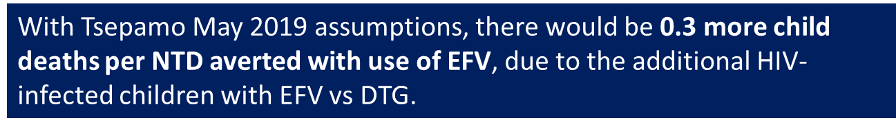
CEPAC: May 2019 Tsepamo
ARV efficacy per NMA, PDR 10.7%
For every 1000 South African WCP with HIV starting ART, per year, compared with EFV (average over 5 yrs):
CEPAC
DTG
DTG-C
DTG
What would be the negative outcomes of avoiding any excess NTDs by using EFV?
1 more NTDs
0 more NTDs#
<1 fewer child deaths*
Fewer child deaths with DTG vs EFV
0 more child deaths#
3 more women alive
1 more women alive
CEPAC: Tsepamo May 2019 NTD risk, NMA ARV efficacy, PDR 10.7%
For every 1 NTD averted with use of EFV compared to DTG, it is predicted that there will be this many additional outcomes:
13 more men without HIV
5 more men without HIV
EFV vs DTG
5 Deaths among women
22 Sexual transmissions
4 MTCT transmissions
3 fewer MTC transmissions
0 fewer MTC transmissions*
<1 more child deaths*
0.3 more child deaths
3 more children alive and HIV-free
0 more children alive and HIV-free*
*n<0.5; #n=0; numbers ≥0.5 rounded up

Slide 10
HIV SYNTHESIS
Imagine a group of 1000 WCP using EFV
How would outcomes compare to
  1000 women using DTG?

Slide 11

SYNTHESIS: May 2019 Tsepamo
Incl. NAMSAL/ADVANCE, PDR 9%
For every 1000 WCP wanting more children starting ART, per year, compared with TLE (average over 20 years):
HIV SYNTHESIS
Imagine a group of 1000 WCP using EFV
How would outcomes compare to
  1000 women using DTG?
TLD
2 more NTD
1 more NND
38 more women alive
38
35 fewer sexual transmissions
35
29 fewer MTC transmissions
29
*n<0.5; #n=0; numbers ≥0.5 rounded up

Slide 12
SYNTHESIS: May 2019 Tsepamo
Incl. NAMSAL/ADVANCE, PDR 9%
For every 1000 WCP wanting more children starting ART, per year, compared with TLE (average over 20 years):
HIV SYNTHESIS
TLD
What would be the negative outcomes of avoiding any excess NTDs by using EFV?
2 more NTD
1 more NND
38 more women alive
38
35 fewer sexual transmissions
35
29 fewer MTC transmissions
29
*n<0.5; #n=0; numbers ≥0.5 rounded up

Slide 13
SYNTHESIS: May 2019 Tsepamo
Incl. NAMSAL/ADVANCE, PDR 9%
For every 1000 WCP wanting more children starting ART, per year, compared with TLE (average over 20 years):
HIV SYNTHESIS
TLD
What would be the negative outcomes of avoiding any excess NTDs by using EFV?
2 more NTD
1 more NND
38 more women alive
SYNTHESIS: Tsepamo May 2019 NTD risk, incl. ADVANCE/NAMSAL, PDR 9%
For every 1 adverse infant outcome (NTD+NND) averted with use of TLE compared to TLD, it is predicted that there will be this many additional outcomes:
38
35 fewer sexual transmissions
TLD vs TLE
21 Deaths among women
26 Sexual transmissions
14 MTCT transmissions
35
29 fewer MTC transmissions
Difference in child deaths not modelled
125 additional DALYs
29
numbers ≥0.5 rounded up
*n<0.5; #n=0; numbers ≥0.5 rounded up

Slide 14
SYNTHESIS: May 2019 Tsepamo
Incl. NAMSAL/ADVANCE, PDR 9%
For every 1000 WCP wanting more children starting ART, per year, compared with TLE (average over 20 years):
HIV SYNTHESIS
TLD
What would be the negative outcomes of avoiding any excess NTDs by using EFV?
2 more NTD
1 more NND
38 more women alive
SYNTHESIS: Tsepamo May 2019 NTD risk, incl. ADVANCE/NAMSAL, PDR 9%
For every 1 adverse infant outcome (NTD+NND) averted with use of TLE compared to TLD, it is predicted that there will be this many additional outcomes:
38
35 fewer sexual transmissions
SYNTHESIS does not model mortality of children with HIV explicitly, but child HIV-related morbidity/mortality included in mother’s DALYs → Each NTD/NND averted using TLE would result in 125 additional child DALYs lost.
TLD vs TLE
21 Deaths among women
26 Sexual transmissions
14 MTCT transmissions
35
29 fewer MTC transmissions
Difference in child deaths not modelled
125 additional DALYs
29
numbers ≥0.5 rounded up
*n<0.5; #n=0; numbers ≥0.5 rounded up

Slide 15
What would this look like in different countries?
HIV SYNTHESIS
 | Estimated number of women giving birth per year | Difference in annual number of AIDS deaths in women wanting more children | Difference in annual number of non-HIV deaths in women wanting more children | Difference in annual number of new adult infections | Difference in annual number of NTDs | Difference in annual number of NNDs due to DTG- induced weight gain | Difference in annual number of MTCT
MALAWI | 54,776 | -480 (-1140, -50) | +70 (-260 - +490) | -1140 (-5630, +3350) | +45 (+16, +81) | +22 (0, 70) | -460 (-1520, +420)
ZIMBABWE | 63,407 | -2040 (-4890, +450) | +110 (-270, +570) | -1700 (-7800, +1350) | +52 (+30, +85) | +26 (0, +64) | -1060 (-2770, -240)
UGANDA | 95,490 | -1100 (-4100, -60) | +80 (-510, +860) | -1630 (-15210, +8600) | +64 (+0, +126) | +29 (0, +101) | -800 (-3240, +240)
CAMEROON | 29,838 | -500 (-1350, +190) | +15 (-180, +250) | -100 (-4760, +5070) | +13 (0 , +41) | +7 (0, +54) | -180 (-1130, +400)
Based on scaling up to the number of women with HIV giving birth in each country
Setting scenarios were selected that “matched” countries with respect to HIV prevalence and incidence, fertility, MTCT rate, PDR, 90-90-90 proportions.
Notes:
I won’t go through this slide in detail, but just to say, HIV Synthesis was able to model various country specific scenarios, in addition to the South Africa- specific modelling of CEPAC, and the results are all highly consistent

Slide 16
Other scenarios considered
What if….
True DTG-NTD association higher/lower than Tsepamo 2019?
Virologic outcomes of DTG vs EFV are similar?
Prevalence of pre-treatment drug resistance higher/lower?
Child health (even if uninfected) affected by maternal death?
Treatment failures on DTG higher than expected?
Substantive interpretations do not change across realistic variations in these (and other) parameters
Notes:
By now you can tell that I’m flying through 100s and 100s of pages of analyses incredibly briefly given the time constraints – and to continue that approach – its important to note that a wide range of sensitivity analyses have been conducted.
These include variations in the putative association between DTG use and NTDs; lower effectiveness to DTG in viral suppression; various levels of background NNRTI resistance; the links between maternal and child health outcomes, and so forth.
Obviously there is not enough time to go through these, though they are all available in the report which fed into the guidelines revision, and the takeaway message is that none o these variations changed the results meaningfully

Slide 17
Caveats and limitations
Models provide high-level, predicted quantitative outcomes to assist decision-making → thought experiments
There are many details and assumptions
No attempt here at value judgements:
how to balance risk versus benefits across different clinical outcomes?
Notes:
These are just computers

Slide 18
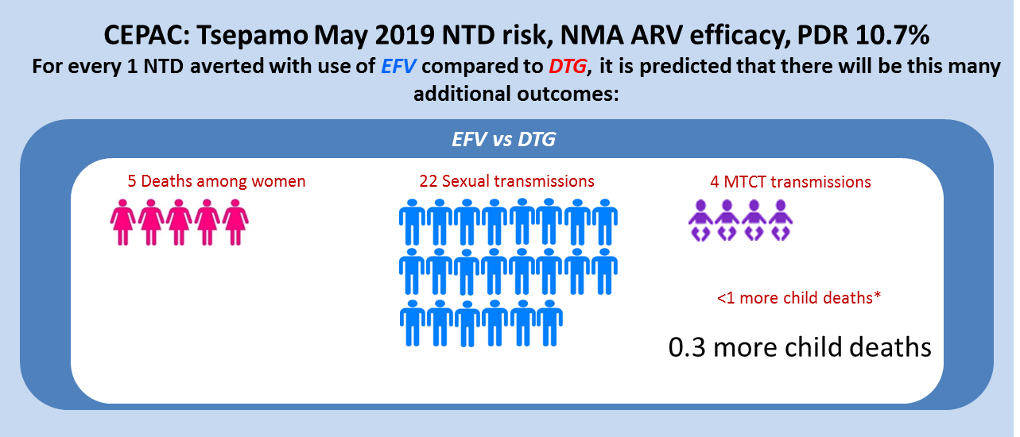
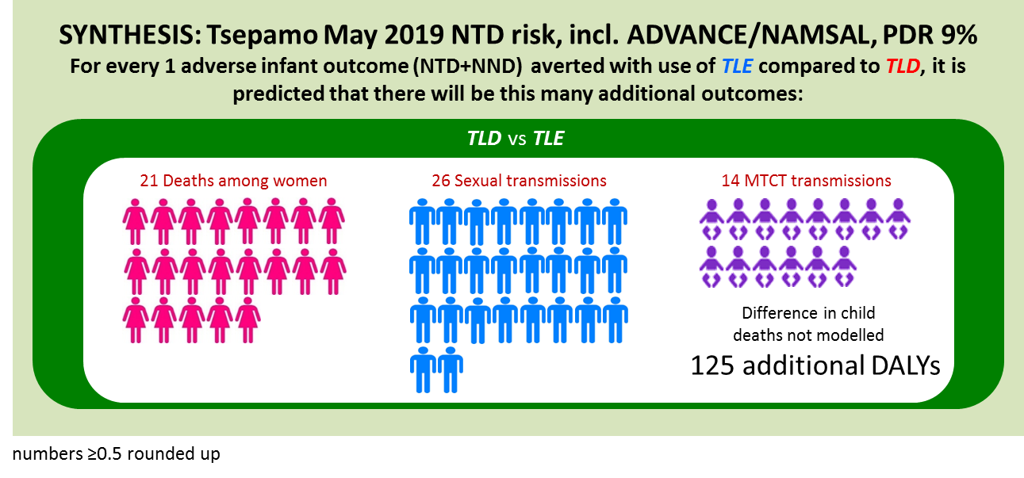
Conclusions
Both models show that for WCP initiating ART use of EFV rather than DTG in order to avoid NTDs would likely lead to other substantial negative impacts at population level
Notes:
And so the real conclusion from this work is that two different simulation models, developed and reported independently, arrived at the same high-level conclusion – that if EFV is recommended as a first line agent in order to reduce the risk of NTDs, we estimate that there will be substantial negative benefits at a population level, including an excess of maternal deaths, child deaths, MTCT and sexual HIV transmissions.

